Slide 1
Instructor Materials Chapter 2: Introduction to Lab Procedures and Tool Use
IT Essentials v6.0
Notes:
Cisco Networking Academy Program
IT Essentials
Chapter 2: Introduction to Lab Procedures and Tool Use

Slide 2
Instructor Materials - Chapter 2 Planning Guide
This PowerPoint deck is divided in two parts:
Instructor Planning Guide
Information to help you become familiar with the chapter
Teaching aids
Instructor Class Presentation
Optional slides that you can use in the classroom
Begins on slide #10
Note: Remove the Planning Guide from this presentation before sharing with anyone.
Notes:
2

Slide 3
ITE 6.0 Planning Guide
Chapter 2: Introduction to Lab Procedures and Tool Use
Notes:
ITE 6.0 Planning Guide
Chapter 2: Introduction to Lab Procedures and Tool Use

Slide 4
Chapter 2: Activities
What activities are associated with this chapter?
The password used in the Packet Tracer activities in this chapter is:
Not applicable for this chapter.
Page Number | Activity Type | Activity Name
2.2.2.3 | Lab | Diagnostic Software
2.2.4.4 | Lab | Using a Multimeter and a Power Supply Tester
2.2.4.6 | Video | Computer Disassembly
2.2.4.7 | Lab | Computer Disassembly
Notes:
4

Slide 5
Chapter 2: Assessment
Students should complete Chapter 2, “Assessment” after completing Chapter 2.
Quizzes, labs, Packet Tracers and other activities can be used to informally assess student progress.
Notes:
5

Slide 6
Chapter 2: Best Practices
Prior to teaching Chapter 2, the instructor should:
Complete Chapter 2, “Assessment.”
The goal of this chapter is to provide information about safety and toolkits.
Ensure that students understand that different tasks require different tools and that the correct tools can drastically reduce the time required to complete a task.
Notes:
6

Slide 7
Chapter 2: Additional Help
For additional help with teaching strategies, including lesson plans, analogies for difficult concepts, and discussion topics, visit the ITE Community at community.netacad.net.
If you have lesson plans or resources that you would like to share, upload them to the ITE Community in order to help other instructors.
Notes:
7

Slide 8
Chapter 2: Topics in chapter that are not found in the CompTIA A+ 220-901 Certification
This slide lists content included in this chapter that is NOT listed in the CompTIA A+ 220-901 blueprint. Instructors could skip these sections; however, they should provide additional information and fundamental concepts to assist the student with the topic.
All content in Chapter 2 is aligned to the certification.
Notes:
8

Slide 9


Slide 10
Chapter 2: Introduction to Lab Procedures and Tool Use
IT Essentials v6.0
Notes:
Cisco Networking Academy Program
IT Essentials
Chapter 2: Introduction to Lab Procedures and Tool Use

Slide 11
Chapter 2 - Sections & Objectives
2.1 Safe Lab procedures
Explain the purpose of safe working conditions and safe lab procedures.
2.2 Proper Use of Tools
Explain how to use tools and software with personal computer components.
Notes:
11

Slide 12
2.1 Safe Lab Procedures
Notes:
Cisco Networking Academy Program
IT Essentials
Chapter 2: Introduction to Lab Procedures and Tool Use

Slide 13
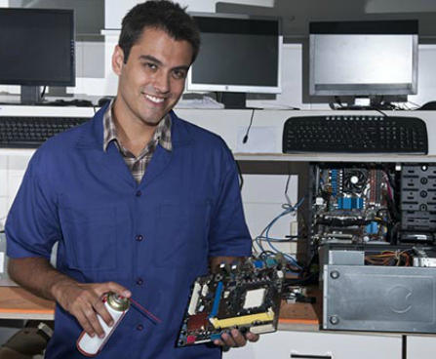
Safe Lab Procedures Procedures to Protect People
General Safety
Make sure a first-aid kit is available.
Unsecured cables create tripping hazards.
Food and drinks should not be in the workspace.
Remove jewelry.
Electrical Safety
Computer power supplies are dangerous when disassembled.
Watch for printer areas that are hot or that use high voltage.
Check the voltage output of AC adapters and chargers before connecting them to devices.
Fire Safety
Turn off the power and unplug equipment before performing service.
Different types of fires require different types of fire extinguishers; make sure to use to correct one.
Be alert for odors emitting from computers and electronic devices.
Notes:
2.1 - Safe Lab Procedures
2.1.1 - Procedures to Protect People

Slide 14

Safe Lab Procedures Procedures to Protect Equipment and Data
ESD and EMI
ESD can cause damage to computer equipment if not discharged properly.
ESD can build up on you as you walk on a carpeted floor.
EMI distorts the signals, degrading computer communication.
EMI can be generated by large motors, power lines, electrical storms, or any other source of electromagnetic energy.
Wireless networks are affected by RFI.
RFI is caused by radio transmitters transmitting in the same frequency.
Environmental temperature and humidity levels also affect computers
Notes:
2.1 - Safe Lab Procedures
2.1.2 - Procedures to Protect Equipment and Data
Electrostatic discharge (ESD)
Electromagnetic interference (EMI)
Radio-frequency interference (RFI)

Slide 15
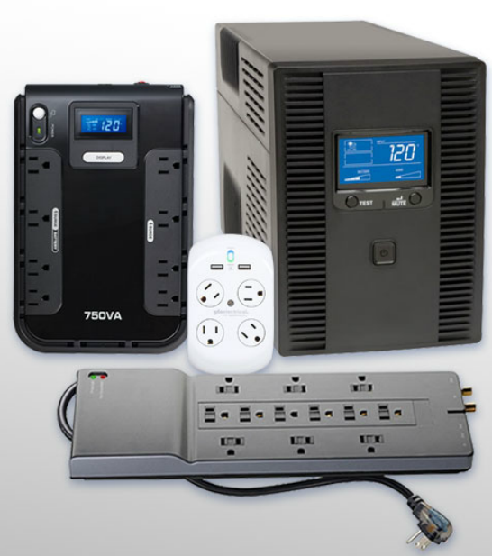
Safe Lab Procedures Procedures to Protect Equipment and Data (Cont.)
Power Fluctuation Types
Power fluctuations may impact the operation of computer components.
Blackouts, brownouts, noise, spike and power surge are types of power fluctuations that can cause data loss or hardware failure.
Power Protection Devices
Surge suppressors, UPSs, SPSs are devices designed to protect computer systems from power fluctuations.
Laser printers should not be plugged to UPSs
Notes:
2.1 - Safe Lab Procedures
2.1.2 - Procedures to Protect Equipment and Data (Cont.)
A brownout is an intentional or unintentional drop in voltage in an electrical power supply system.
Power Spike – A very short pulse of energy on a power line. Power spikes can contain very high voltages – up to and beyond 6000 volts.
A power surge is basically a spike in your home's electrical current.

Slide 16
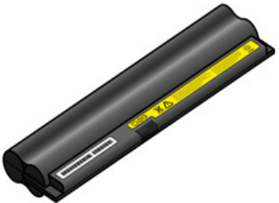
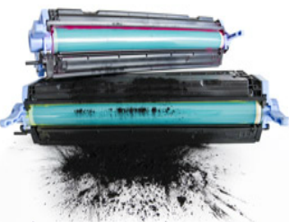
Safe Lab Procedures Procedures to Protect the Environment
Safety Data Sheet
Use an SDS to obtain information about a material, including procedures for proper disposal.
The SDS contains information on the material’s composition, how it can affect personal health, fire hazards, and first-aid requirements.
It also includes protective measures for the safe handling and storage of materials and spill, leak, and disposal procedures.
Equipment Disposal
Computer equipment contains hazardous materials and should be properly disposed.
Follow regulations to protect the environment and avoid fines.
Batteries, monitors, toner kits, cartridges, developers, chemical solvents and aerosol cans are examples of equipment that must be properly disposed.
Notes:
2.1 - Safe Lab Procedures
2.1.3 - Procedures to Protect the Environment
*

Slide 17
2.2 Proper Use of Tools
Notes:
Cisco Networking Academy Program
IT Essentials
Chapter 2: Introduction to Lab Procedures and Tool Use

Slide 18
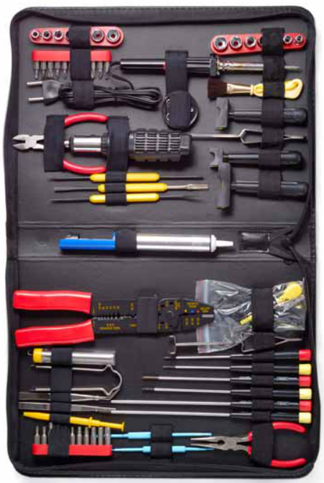
Proper Use of Tools Hardware Tools
Hardware tools are grouped into:
ESD Tools
Antistatic wrist strap and antistatic mat
Hand Tools
Include screwdrivers, flashlights and pliers.
Cable Tools
Include wire cutters and strippers, crimpers and punch down tool.
Cleaning Tools
Include special cloths, chemicals and cable ties.
Diagnostic Tools
Include digital multimeters, loopback adapters, WiFi analyzer, external HDD enclosure
Notes:
2.2 – Proper Use of Tools
2.2.1 - Hardware Tools

Slide 19
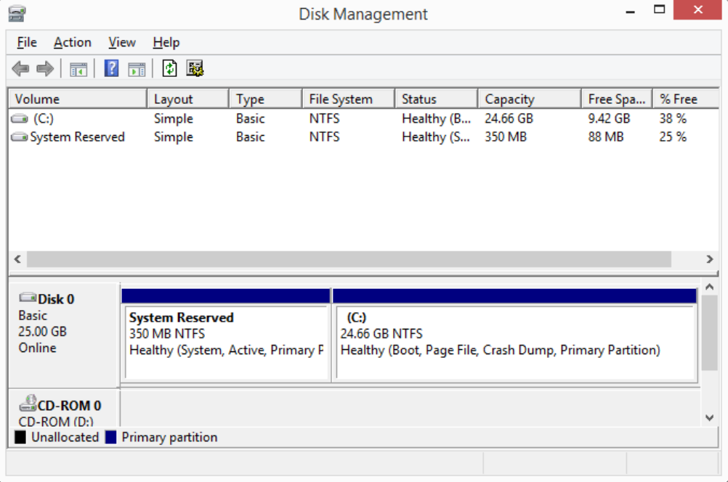
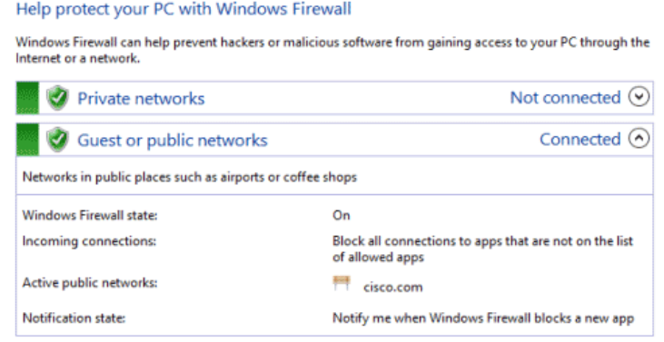
Proper Use of Tools Software Tools
Like hardware tools, software tools are task-specific.
Used to diagnose problems, maintain hardware, and protect the data stored on a computer.
Disk Management Tools
Used for disk management, formatting, error checking, drive optimization, disk cleanup and more.
Protection Software Tools
Malicious software can damage or compromise operating systems, applications, and data.
Software protection tools include antivirus, antispyware, firewalls and update manager software.
Notes:
2.2 – Proper Use of Tools
2.2.2 – Software Tools

Slide 20
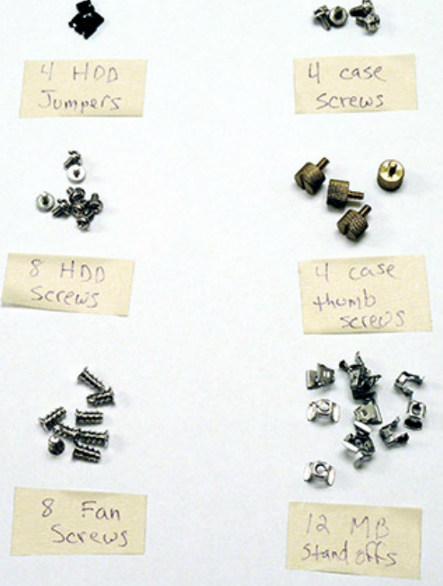
Proper Use of Tools Organizational Tools
It is important that a technician document all services and repairs for future reference.
Personal Reference Tools
Include troubleshooting guides, manufacturer manuals, quick reference guides, and repair journals.
History of repairs and a notepad can be extremely useful as a technician performs troubleshooting and repairs.
The Internet can be a great reference tool by providing access to specialized forums, search engines, manufacturer’s FAQs, and more.
Miscellaneous Tools
Additional secondary items can be added to the toolkit.
Masking tape, a working computer and even pencil eraser can be very useful additions to a technician’s kit.
Notes:
2.2 – Proper Use of Tools
2.2.3 – Organizational Tools

Slide 21
2.3 Chapter Summary
Notes:
Cisco Networking Academy Program
IT Essentials
Chapter 2: Introduction to Lab Procedures and Tool Use

Slide 22
Chapter Summary Summary
This chapter discussed safe lab procedures, correct tool usage, and the proper disposal of computer components and supplies.
Work in a safe manner to protect users and equipment.
Follow all safety guidelines to prevent injuries to yourself and others.
Know how to protect equipment from ESD damage.
Know about and be able to prevent power issues that can cause equipment damage or data loss.
Know which products and supplies require special disposal procedures.
Familiarize yourself with the SDS for safety issues and disposal restrictions to help protect the environment.
Be able to use the correct tools for the task.
Know how to clean components safely.
Use organizational tools during computer repairs.
Notes:
2.3.1.1 - Summary

Slide 24


Slide 25
Section 2.1 New Terms and Commands
ac
acid
aerosol
alkaline
antistatic
backup
barium
base
blackout
cadmium
cartridge
cellular
combustible
concentrations
conduit
copper
cordless
current
decay
discharge
electromagnetic
electrons
electrostatic
epa
emi
esd
fuse
hydride
inkjet
kerosene
lithium
manganese
moisture
msds
nickel
osha
rfi
sds
shock
Notes:
New Terms and Commands

Slide 26
Section 2.1 New Terms and Commands (Cont.)
solar
solvents
spike
sps
storyboard
surge
temperature
transformer
uninterruptible
ups
warranty
wrist
Notes:
New Terms and Commands

Slide 27
Section 2.2 New Terms and Commands
alcohol
ammoniated
amperage
analyzer
antistatic
antivirus
auditing
blades
bolt
chassis
chkdsk
circuit
cm
coating
conductive
conductor
damp
dc
defrag
diagnose
driver
faqs
firewall
fluke
format
forums
gain
hex
impurities
induce
insulator
isopropyl
lcd
lead
multimeter
overheat
phillips
scandisk
Screwdriver
sfc
spyware
toolkit
Notes:
New Terms and Commands

Slide 28
Section 2.1 New Terms and Commands (Cont.)
torx
vacuum
velcro
viruses
wifi
wireless
workbench
Notes:
New Terms and Commands

